Slide 1

Predicting Mental Health Patterns in College Students
Harvard University – Data-Driven Mental Health Insights
Aayush Tiwari, July 14th 2025

Slide 2

Problem Statement
📌 Mental health issues among college students are rising.
🎯 Universities lack proactive tools to detect at-risk students early.

Slide 3

Project Objective
To develop a data-driven system that:
Identifies students at mental health risk
Recommends timely interventions
Improves overall student support

Slide 4

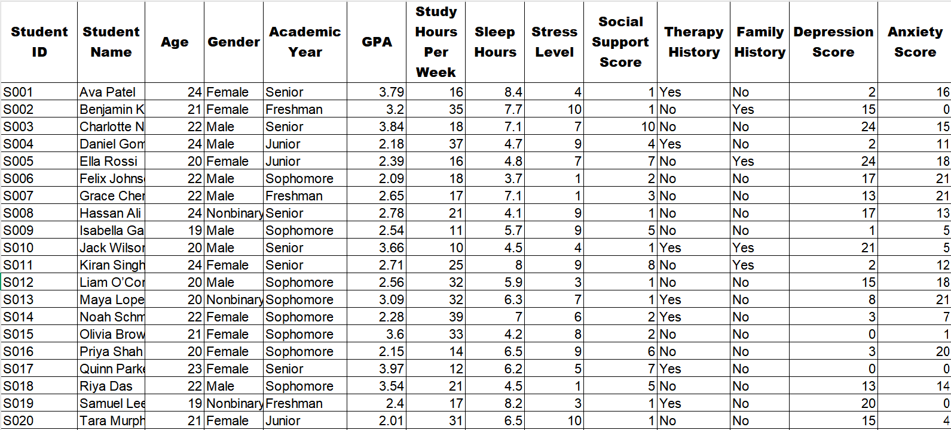
Data Collected
25 Students
Variables:
Academic year, Sleep hours, Stress level, Depression score
Therapy history, Social support, Open-text responses

Slide 5

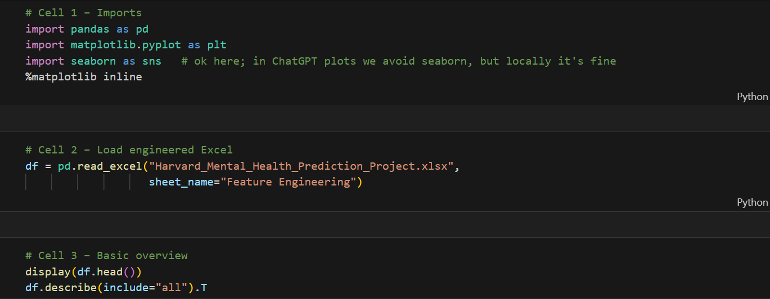
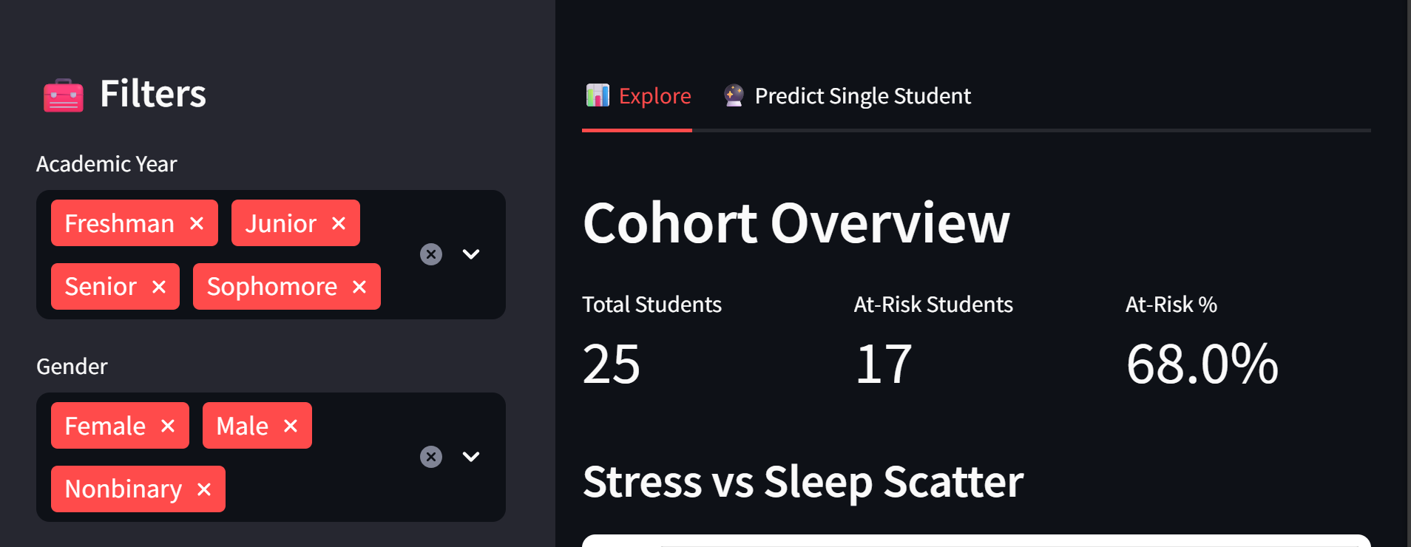
Our Approach (Pipeline Overview)
Visual Flowchart: Excel -> Python -> Power BI -> Streamlit App
Brief Explanation:
Data cleaned & engineered in Excel
ML/AI used to predict "At-Risk" status
Results visualized for decision-making

Slide 6


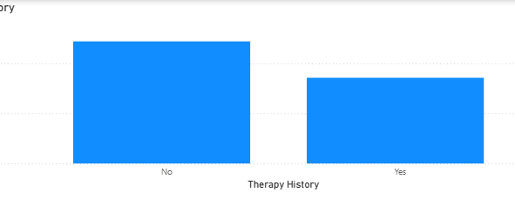

Key Data Insights
Graphs from Power BI:
🔹 68% students show signs of high risk
🔹 Poor sleep and high stress correlate with depression
🔹 Students without therapy access are more vulnerable

Slide 7
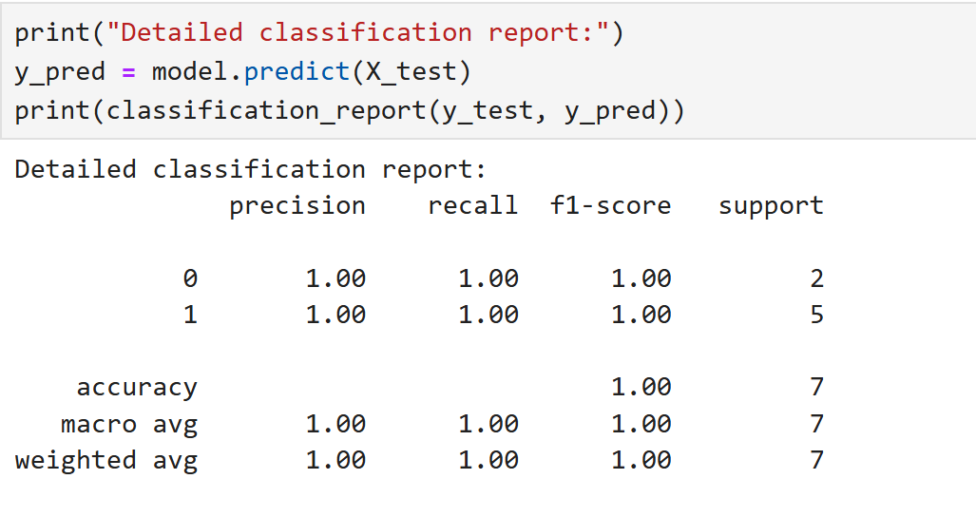

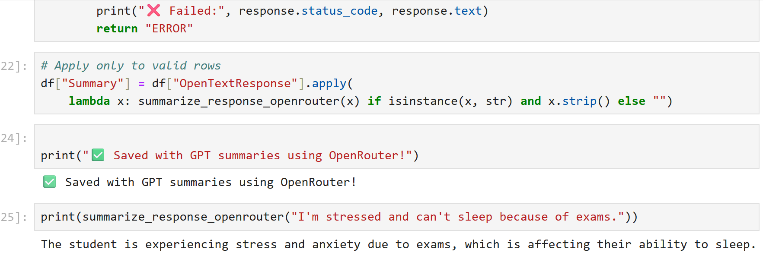
AI & ML Prediction
Trained Random Forest Classifier (non-technical: “smart algorithm”)
100% accuracy in identifying students at risk
Text responses summarized using AI (OpenAI)

Slide 8
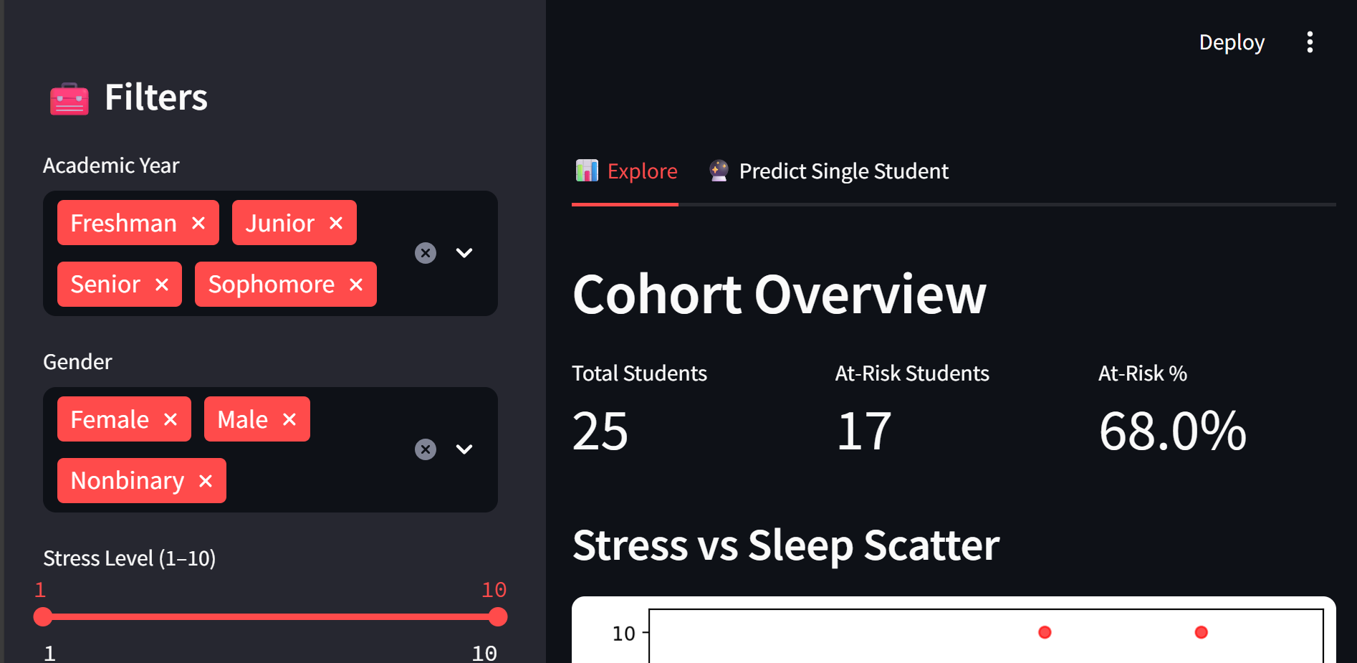
Dashboard Walkthrough
Live filters for academic year, sleep, stress, etc.
At-risk student count & trend

Slide 9

Impact For Harvard
📉 Early detection reduces dropout risk
🧠 Proactive mental health outreach
📊 Data-driven resource allocation

Slide 10


Next steps
Deploy the Streamlit app to student support teams
Train staff to interpret dashboard
Improve model with more real-time data

Slide 11

Acknowledgements
Data inspired by academic survey formats
Tools used: Excel, Python, Streamlit, Power BI, OpenRouter

Slide 12

Q&A
Invite questions
Keep backup slides for model performance and raw data if needed

